Slide 1
QUESTION ONE
2016
91403

Slide 2
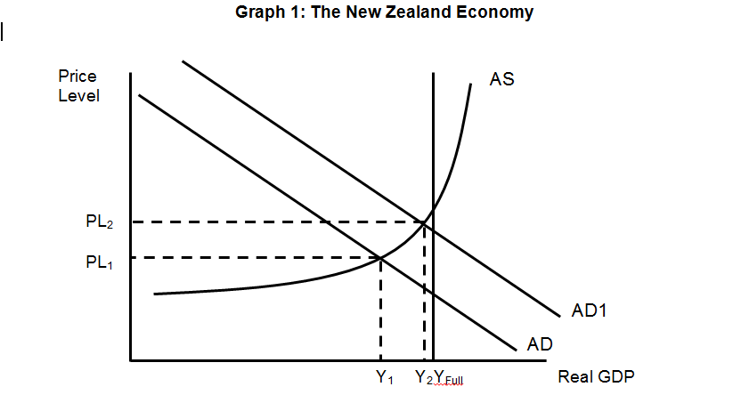
a)

Slide 3
b)
Government spending on roading and transport stimulates extra production
This creates additional income for firms who provide the required construction services such as roading contractors.
As ‘G’ is a component of aggregate demand, so increases in G will result in AD increasing.
This is shown on the Graph as a shift of AD to the right to AD1.
Price Level increases from PL1 to PL2 so inflation rises
GDP increases from Y1 to Y2 so Economic growth increases

Slide 4
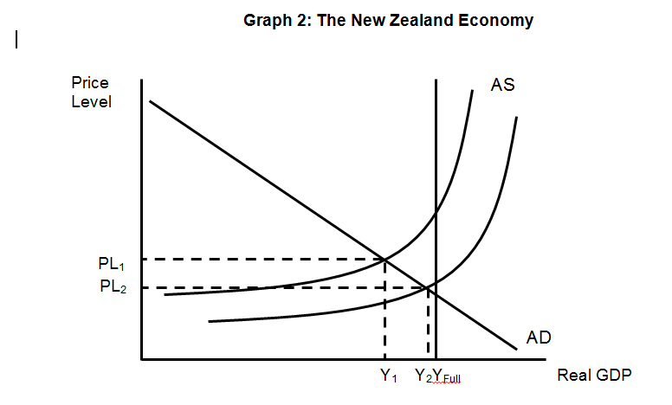
b)
AS1

Slide 5
d)
Simplification of the taxation system will lower compliance costs for businesses.
This will decrease cost of production and increase profitability
so there is an incentive for firms to increase production.
AS increases, as shown by a shift to the right to AS1.

Slide 6
e)
Both increasing spending on transport infrastructure and simplifying the tax system will result in increased economic growth.
Government spending on infrastructure is actually payments to producers to carry out construction activity such as building new roads.
This creates increased production. The new income also results in increased profits for the business owners and income for their workers which will flow into households and further increase spending.
This is shown in Graph 1 as the AD curve increasing. The extra production results in an increase in GDP, Y₁ to Y₂ creating economic growth.
Simplifying the taxation system will reduce compliance costs for businesses, as it will reduce cost of production.
Firms will become more profitable and have a greater incentive to increase production. GDP will increase, as shown in graph 2, Y₁ to Y₂ creating economic growth.

Slide 7
The impact of these policies on Price Level in the short run is different.
For increased spending on infrastructure, the increase in AD to AD1 as shown in graph 1 it results in Price Level increasing to PL₂ , so it is inflationary.
The simplified taxation system, however, causes AS to increase, AS to AS1 in graph 2. The shift results in a reduction in price level, PL1 to PL2. As firms are motivated to produce more and supply will increase across many markets, and prices will fall to clear surpluses.
The increase in AD of $19.5b exceeds the increase in AS of $600M. Therefore the inflationary pressure from AD > deflationary pressure from AS so net effect is increase in price level.
In the long run the inflationary impact of the spending on infrastructure is likely to lessen, as the added infrastructure is likely to increase productivity and lower production costs causing AS to move outwards. This reduces the inflationary impacts of the initial increase in AD and would allow more growth.

Slide 8
QUESTION TWO
AD and AS increasing on graph
b)
AD will increase as the increased population will create an increase in consumer spending on goods and services C.
This will result in increases in production and profit
Income for households will increase as it flows around the economy.
So spending will increase ( C ) as this is a component of AD it will increase AD shifting to the right ,AD to AD1 in Graph 3

Slide 9
AS increases as there is an increased availability of workers which should result in lower wage costs.
So Cost of Production decreases and AS increases.
Also many of the migrants will have skills which NZ is short of which should also increase productivity.
Firms have increased incentive and ability to increase output so AS increases, shifting to the right, AS to AS1 in Graph 3

Slide 10
c)
New Zealand’s economy relative to other’s overseas, especially Australia, has been performing well.
As a result there has been an increasing inflow of immigrants, either kiwis returning home or new arrivals.
At the same time fewer people leaving NZ.

Slide 11
As we have seen in Graph 3, positive net immigration results in an increase in both AD to AD1 and AS to AS1.
This means that both the demand for goods and services will increase but also that economy will have an increased production to meet this increased demand.
Demand for infrastructure such as housing will especially increase, resulting in increased construction activity, both in the private sector and by government.
Increasing property prices further stimulate consumer confidence and consumer spending.
Both of these shifts are expansionary so GDP will increase from Y₁ to Y₂, causing economic growth.

Slide 12
The impact on employment is less clear. The increase in production will result in a bigger demand for labour, and more jobs will be created, especially in areas such as construction and retail.
This is shown on Graph 3 as the movement from Y₁ to Y₂ which generates more demand for workers.
Demand for workers is a derived demand as it depends on increase in output.
At the same time the overall size of the work force will increase as the new migrants start to seek employment.
So increased unemployment may result when the number of new arrivals is greater than the new jobs they create. The BNZ and other banks are predicting that this is the case currently and unemployment will continue to rise through 2016.

Slide 13
QUESTION THREE a)
The TPPA will result in a $259mill increase in export earnings as the tariffs are removed.
This is shown by the export receipts flow on the circular flow model (CFM).
Producers will be receiving a higher profit and will have an incentive to increase production, resulting in increased employment and therefore increasing the flow of incomes, both wages and profits, to households as shown by the income flow.
Households will have increased disposable income, so spending on goods and services will increase further benefiting producers. This would increase the consumer spending flow.

Slide 14
The government would also benefit from both direct taxes on the increased income, indirect tax flow, (GST )on the increased consumption spending.
Import payments are likely to increase as some of the increased consumption will be on overseas goods
The removal of NZ tariffs would cause the import payments flow to increase, as NZ buys more imported goods rather than locally produced.
This will result in less income for local producers and their workers and would negate some of the gains above due to the increased leakage.
Overall, the impact will be more positive, as the gains for exporters at $259 million are much greater than the $20 million cut from import tariffs. This indicates the level of tariffs was already low, so the negative impacts will be less.

Slide 15
b)
If MPS is 0.17, then MPC = 0.83
So Multiplier effect will be $259 /1 - 0.83= $259/0.17 = $1524 million
This effect is due to the flow on effects shown in the circular flow model. The extra income results in additional spending.
This increases production and then income again and so on. The increase in GDP includes the additional growth in spending as the money flows around the economy.

Slide 16
b)
If MPS is 0.17, then MPC = 0.83
So Multiplier effect will be $259 x 1/1 - 0.83= $259/0.17 = $1524 million
This effect is due to the flow on effects shown in the circular flow model. The extra income results in additional spending.
This increases production and then income again and so on. The increase in GDP includes the additional growth in spending as the money flows around the economy.

Slide 17
If the MPS was 0.10, then GDP would actually increase by $259 / 1-0.90 = $259/.10 = $2,590 million.
A key factor in the size of the multiplier is the leakage due to saving. Each cycle, the income is either spent or saved.
The lower the saving, the higher the spending and the bigger the multiplier effect.
When households are feeling confident about the economy they tend to save less and are encouraged to spend more as they do not fear losing their source of income.
This lowers the MPS
This shows that the overall impact on economic growth of joining the TPPA will be much greater in times of high consumer confidence.

