Slide 1
CETA GROWTH - 2014
ANSWERS

Slide 2
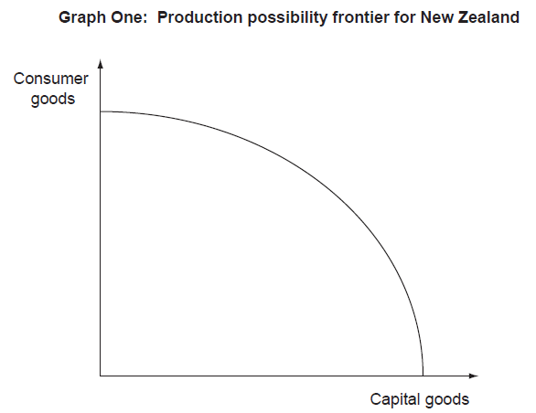
QUESTION ONE (a)
PPC 1
PPC

Slide 3
QUESTION ONE (b)
Increasing net migration will increase productive capacity and economic growth. An increase of 29,000 migrants will increase labour resources in New Zealand - the size of the NZ labour force/ population/ human resources. The increase in resources available for production increases productive capacity for both CAPITAL and CONSUMER goods which will shift the whole PPC outward from PPC to PPC1. This will result in economic growth in the medium and long term.

Slide 4
QUESTION ONE (c)
Households (Positive and Negative effects)
Economic growth will increase demand for labour/ employment opportunities but there will be increased competition for new jobs from migrants. Economic growth may increase employment and incomes but some of this will be offset by increasing inflation due to increased aggregate demand (consumption spending by households and new migrants) OR increased house price inflation caused by increased demand for housing by migrants.

Slide 5
QUESTION ONE (c)
Government (Positive and Negative effects)
Economic growth will increase direct and indirect tax revenue for the government due to increased employment/ producer profits/ consumption spending as well as reduced spending on transfer payments due to increased employment opportunities. However increased migration may place additional pressure on funding for public goods and services e.g. health and education

Slide 6
QUESTION ONE (c)
Environment
Increased economic growth places pressure on resources which must be managed sustainably to ensure possible future growth. Increased growth caused by increased migration places pressure on communities in terms of over-crowding or congestion. Increased economic growth creates pollution (aural/ visual/ waste) which has a negative impact on the environment.

Slide 7
QUESTION ONE (c)
Combined impact (Use AD components)
With increased human resources productive capacity increases increasing potential output in the future, this is sustained by increasing aggregate demand from increased consumption spending. Increased business confidence due to increasing economic growth may increase investment spending, increasing productive capacity further. The government may increase funding for infrastructure or social/public services with increased tax revenue increasing future growth.

Slide 8
QUESTION TWO (a)
C = Consumption spending (by households)
I = Investment spending (by firms)
G = Government spending
(X-M) = net exports (export receipts – import payments) (Exports-imports) is incorrect

Slide 9
QUESTION TWO (b)
Shift AD curve to right and fully label
Increased consumer confidence will increase economic growth as consumers feel confident about employment prospects and personal finances. They “feel it is a good time to buy things they want and need”, this will increase consumption spending which is a component of AD and lead to an increase in real output.
This will shift the AD curve to the right from AD to AD1. Increased AD will be met by increased production of goods and services shown by the increase in real output from Y to Y1.

Slide 10
QUESTION TWO (c)
An increase in business confidence will mean that “firms will feel sufficiently confident to invest and hire”. An increase in investment spending by firms on capital goods will increase I as a component of expenditure based GDP. As Investment is a component of AD, which will increase leading to increased real output.
This will shift the AD curve further right from AD1 to AD2. The increase in production of both capital and consumer goods to meet increased AD is shown by the increase in real output from Y1 to Y2.

Slide 11
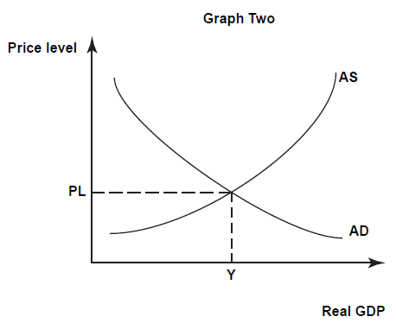
PL2
PL1
AD2
AD1

Slide 12
QUESTION TWO (c)
AD shifted further to the right but not by as great a shift as AD to AD1. This shows the impact of increasing investment is smaller than the impact of increased consumption. This shown in the expenditure approach calculation shown above - consumption spending is $126b of GDP whereas investment spending is only $43b. Consumption is 59% of GDP whereas investment is only 20% of GDP.

Slide 13
QUESTION THREE
(a)
(i) Goods and Services
(ii) Incomes
(iii) Resources
(b) The deep sea oil drilling will create jobs (“rising employment”) in Otago which will increase household incomes. The drilling company will also purchase other goods and services in the region (accommodation, meals, resources) which will increase revenue and profits (a possible “$700million in riches”) for local suppliers and support industries

Slide 14
QUESTION THREE (c )
Impact of deep sea oil exploration can explained using the 3 different measures of growth.
(i) Real Output: Deep sea oil drilling will increase real output because it will increase the number of goods and services being produced. These will include goods and service related to oil drilling (including possible investment from overseas) as well as goods and services demanded from local suppliers due to increased incomes and employment.
However, if increased incomes are concentrated in a few specialised jobs or profits go off-shore then the impact on the local economy will be limited.

Slide 15
QUESTION THREE (c )
(ii) Productive Capacity: The potential output/ productive capacity will increase because if the oil drilling is successful there will be an increase in resources in the economy that can be used to increase output (the PPC will shift to the right for the whole economy with discovery of new resources). Productive capacity may increase due to increased investment in the drilling process by the oil industry.
However, if there is an oil spill or adverse environmental impact then the productive capacity of the region will be reduced (PPC shifts inward) because the tourism and fishery resource will be destroyed.

Slide 16
QUESTION THREE (c )
(iii) Net Social welfare: Net social welfare may decrease because many of the economic benefits will “go to overseas specialists” meaning the increases in incomes for the local economy will be limited and/or short term in nature. If there are negative environmental impacts then the incomes of tourism and fishery workers will decrease. Negative non-economic impacts may also include pollution, congestion, destruction of wildlife and fishery habitats compromising quality of life. If there is an uncontained oil spill then damage to the environment may be long term and would have both economic (the destruction of Dunedin’s $100 million-a-year wildlife tourism industry) and non-economic impacts that would reduce standard of living and quality of life.

Slide 17
QUESTION THREE (c )
The best measure to evaluate the overall impact of standard of living of people in the region is net social welfare. Real output will only measure if income/output has increased. Productive capacity will only measure if more output is possible (not if it has actually increased).
Net social welfare will evaluate economic and non-economic measures e.g. changes in real income as well as the possible environmental impact which is a better overall measure of quality of life.

