Slide 1
HUMAN RESOURCE MANAGEMENT
Key Points

Slide 2
PUTAKE (SOURCE)
What performance indicators are important for each business may vary.
An Iwi-owned land collective may measure performance very differently to a privately-owned retail chain.
Business with a putake founded in community well-being may be more inclined to employ HR practices that benefit the community first and foremost.
A business founded on providing a financial return to it’s investors, may employ HR practices that give a strong financial return

Slide 3
Human resources are one of the most important features of many businesses.
Human resources account for a large proportion of many businesses' costs.
It is the people working in a business that invariably drive a business.

Slide 4
Range of factors to be considered

Slide 5
MOTIVATION and PRODUCTIVITY
Productivity is a key measure of how efficiently a business is operating.
It is usually calculated by measuring the output for each unit of input (Output / Input)
This can be measured through:
Profit
Revenues
Growth in sales
Market share

Slide 6
An important driver of productivity is motivation of workers.
Poor motivation leads to:
Lower productivity levels
Poor quality products and services
High levels of complaints from customers
Loss of customers with subsequently lower revenues
Higher costs
Higher staff turnover
Poor industrial relations

Slide 7
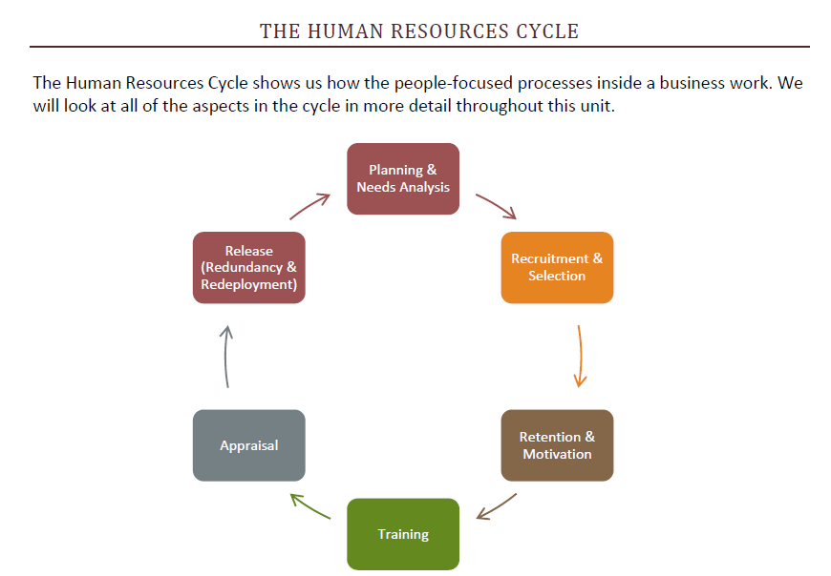

Slide 8
Needs Analysis
For most businesses, large or small, the task of identifying what work needs doing and who should do it is a continuous challenge!
Why a business might need to recruit staff:
Business expansion due to
Increasing sales of existing products
Developing new products
Entering new markets

Slide 9
Existing employees leave:
To work with competitors or other local employers
Due to factors such as retirement, sick leave, maternity leave
Business needs employees with new skills
Business is relocating – and not all of existing workforce want to move to new location

Slide 11
Staff Retention
All businesses are affected by staff ‘turnover’.
Turnover refers to the human resource movement from a department or organisation. That is, employees moving on from a job for one reason or another.
The effectiveness of HRM programmes and activities can be seen by the turnover.
Effective management of turnover can identify problem areas and help HRM to develop suitable strategies.
A high turnover of staff due to retention issues, this will result in low staff morale, poor service delivery, damage to your organisation brand and your reputation in the market place, and most importantly will be impacting on your financial bottom line.

Slide 12
MOTIVATING STAFF
Motivation is what stimulates and drives an individual towards achieving a result.
2 Theories are considered relevant:
Maslow's hierarchy of needs theory
Herzberg's motivator - hygiene theory

Slide 13
Maslow's hierarchy of needs theory
Self - Esteem
Self - Actualisation
Self - Esteem
Belonging
Security
Needs & Basic Wants

Slide 14
Herzberg's motivator - hygiene theory
Two categories under this theory – Motivating and Environmental factors.
Motivating Employee Activities – Job Satisfaction Category
completing challenging work
receiving recognition
gaining responsibility
promotion
achieving goals

Slide 15
2. Environmental factors – Job Dissatisfaction
The theory suggests that these factors won't motivate an employee or make them satisfied with their job, but their absence will create job dissatisfaction.
company policy,
supervision,
workplace conditions and
salary

Slide 17
TRAINING & DEVELOPMENT
Training can be defined as:
The process of increasing the knowledge and skills of the workforce to enable them to perform their jobs effectively
Training takes place at various points and places in a business. Commonly, training is required to:
Support new employees (“induction training”)
Improve productivity
Increase marketing effectiveness
Support higher standards of customer service and production quality
Introduction of new technology, systems or other change
Address changes in legislation
Support employee progression and promotion

Slide 18
Benefits of training for a business
1. Higher quality
2. Better productivity
3. Improved motivation - through greater empowerment
4. More flexibility through better skills
5. Less supervision required (cost saving in supervision)
6. Better recruitment and employee retention
7. Easier to implement change in the business

Slide 19
Lack of training – Problems
Problems that businesses will face if there is no training given to staff:
Poor quality
Missing deadlines
Accidents
Wastage of materials
Incorrect instructions
Misuse / misallocation of budget
Equipment failure
Reduced output
Increased costs

Slide 20
APPRAISAL
Employee evaluations are a way managers can assess job performance and provide feedback to employees. An employee appraisal is a method of measuring employee job performance.
Types of Appraisal systems:
Top-Down Appraisal is used most commonly. Productivity, behaviour and goal completion are generally measured by the supervisor.
Management by Objectives, also called MBO, involves management and employee collaboration on goal setting. Once goals have been set and agreed upon, management uses the outcomes to provide feedback.

Slide 21
Self-Assessment is an assessment of performance done by the employee himself or herself
360 Degree Feedback is a form of feedback about an employee's performance from many different people within the company and outside the company.

Slide 22
EMPLOYMENT RELATIONS
Rights and Responsibilities

Slide 23
Change Management
The performance of employees is affected by changes in the organisation.
Changes can be of two types – Internal and External.
Internal: Led by Senior Management
External: Led Employment laws and Economic conditions.

Slide 24
The management and minimisation of the effects of these forces lies in the hands of Human Resources Managers in order to maintain employment relations.
Employment relations is the maintenance of the interaction between the employees, and the employer.
Keys areas of interactions are:
outcomes of performance appraisals,
provision of Employee Assistance Programmes,
counselling,
dispute resolution, and
training & development needs of the employees.

Slide 25
Rights and Responsibilities
At the very foundation of every employee – employer relationship are rights and responsibilities:
Rights: “An entitlement to something”
Responsibilities: “A legal duty to pay or do something; to fulfil obligations”
Both employers and employees have rights and responsibilities in the employment relationship.
Employers meet their responsibilities to employees in a way which best serves the business objectives.
Many of these rights and responsibilities are cemented in law.

